Slide 1
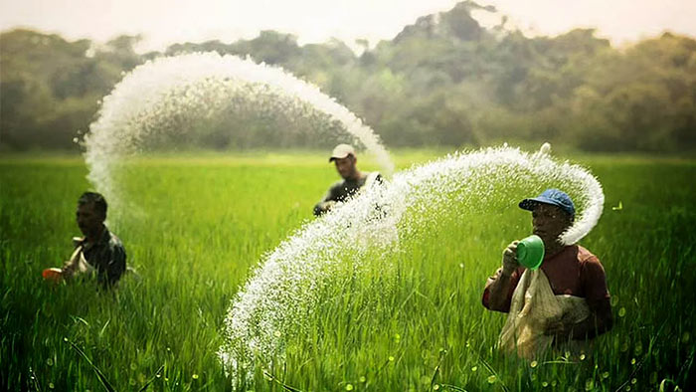


REPORT ON- Market and Business Environment Report—Agrochemicals
Prepared By:
Prepared For:
www.chemanalyst.com
January 6, 2022

Slide 2
Report Content
Sl. No.
Report Content
Page No.
1
PRODUCT OVERVIEW
4
2
RESEARCH METHODOLOGY
6
3
EXECUTIVE SUMMARY
8
4
GLOBAL AGROCHEMICALS MARKET OUTLOOK
11
5
INDIA AGROCHEMICALS MARKET OUTLOOK
16
6
SUPPLY AND DEMAND ANALYSIS
38
7
IMPORT & EXPORT
39
8
VALUE CHAIN ANALYSIS
40
9
COMPETITIVE LANDSCAPE
43

Slide 3
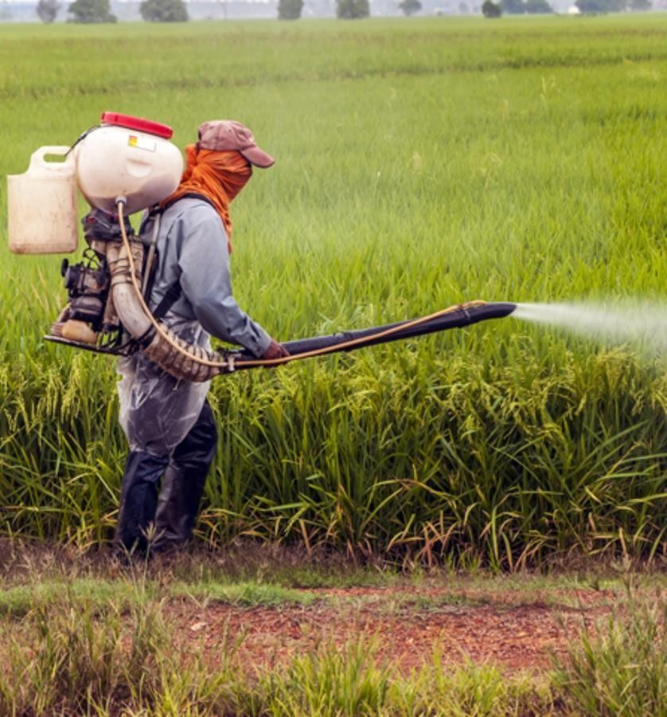
Agrochemicals

Slide 4
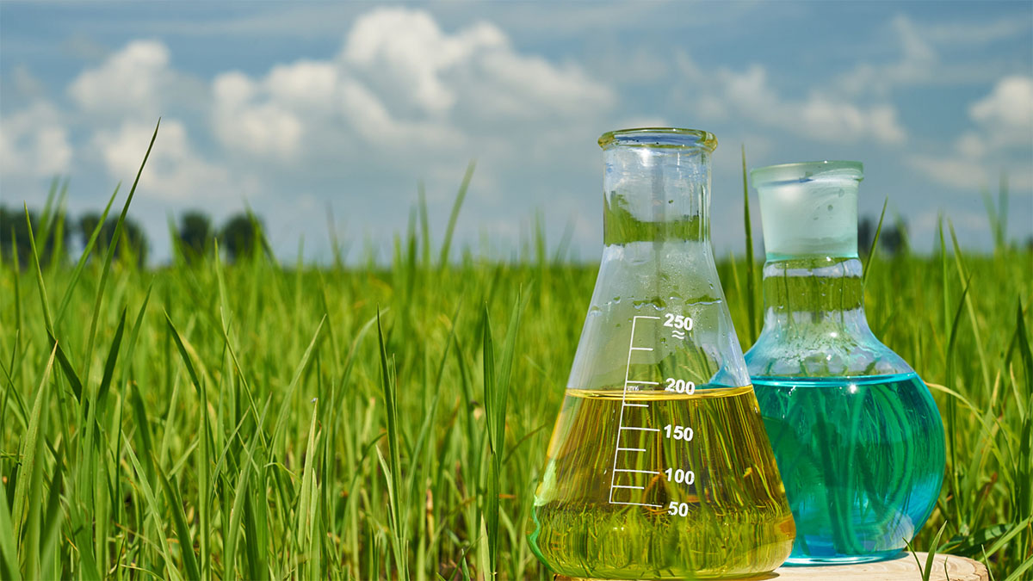
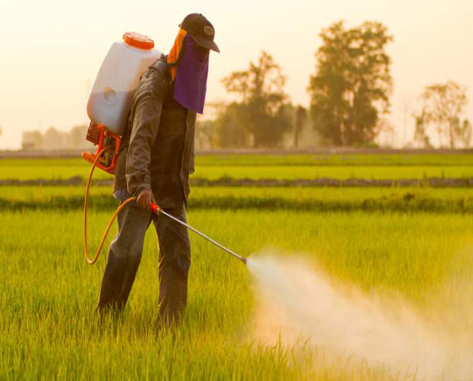
Product Overview- Agrochemicals
Agrochemicals are pesticides, herbicides, or fertilizers used for the management of ecosystems in agricultural sectors. Rudimentary variations on agrochemicals have been used for millennia to improve crop yields and control the populations of agricultural pests.
The earliest known use of agrochemicals dates to roughly 2500 B.C. when Sumerian farmers relied on Sulphur (S) compounds to reduce insect populations and the subsequent risk of pest-related famine.
Types of Agrochemicals-
There is a concerted effort to actively and conscientiously implement a broad range of agrochemicals to safely maintain and control the global food supply to ensure consistently high quality for widespread consumption. Types of agrochemicals include:
Pesticides, or chemicals engineered to destroy insects and other organisms, weeds, and funguses that could spoil crop yields;
Synthetic fertilizers, for example ammonium nitrate (NH4NO3), which is designed to encourage crop growth by saturating soils with nutrients;
Acidifiers and liming agents, engineered to alter the pH levels of soils to suit the planting properties of given crops;
Soil conditioners, for example gypsum (CaSO4·2H2O), which is designed to condition soils with high sodium (Na) contents to improve planting conditions;
Growth hormones, or synthetic chemicals designed to increase growth rates in animals and crops.

Slide 5

RESEARCH METHODOLOGY

Slide 6
Research Methodology
The methodology for this study was based on exhaustive Secondary Research followed by extensive Primary Research. ChemAnalyst deployed a dedicated team who worked dedicatedly for the Client to meet research objectives.
Phase-I: Secondary Search
The team conducted exhaustive secondary research to collect the information on required set of data /information
Phase-II: Formulating Questionnaire & Developing List of Respondents
Based on understanding developed though secondary search, ChemAnalyst team formulated a guideline and developed list of respondents to ask specific questions related with the project objectives for each type of stakeholders (Manufactures, Distributors/ Traders/ Exporters / Importers, Government/ Research/ Regulatory Organisations/ Associations and Industry experts.
Phase-III: Extensive Primary Search
ChemAnalyst executed primary surveys targeting key participants including industry experts through Telephonic/ Face to Face methodology. ChemAnalyst performed periodical checks on data being collected through field surveys with logic checks and analyze survey results.
We completed multiple interviews in one organisation at different levels (Mid-Senior) and departments (Sales, Marketing, Production, etc)
Phase-IV: Analysis of Information Developed and Submission of Report
ChemAnalyst completed the analysis of collected set of information for target products and summarized key findings to client in the form of Report

Slide 7
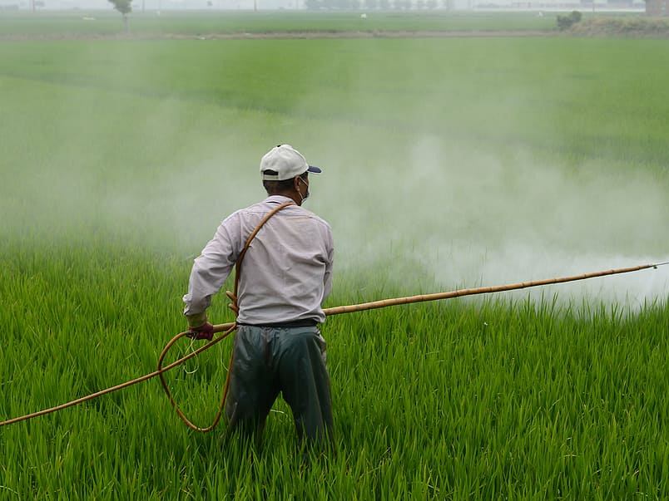
EXECUTIVE SUMMARY

Slide 8
Executive Summary
India Agrochemicals Market Size, By Value (USD Billion), 2017, 2021, 2025F, 2030F, 2035F, 2040F
CAGR 2021-2027F
10.4%
CAGR 2030F-2040F
8.4%
India agrochemicals market stood at USD 6.3 billion and is expected to reach USD 15.2 billion at a CAGR of 10.4% by 2030 and USD 34.7 billion by the end of 2040 at a CAGR of 8.4%.
CAGR 2017-2021
8.3%
Global Market: 2017 – USD 196.6 Billion
2021 - USD 220.3 Billion
2040F – USD 454.1 Billion
India Agrochemicals Market Size, By Volume (in MMT), 2017, 2021, 2025F, 2030F, 2035F, 2040F
CAGR 2025E-2027F
9.8%
The dynamics of India's manufacturing sector are improved through programs like "Make in India" and the PLI Scheme, which leads to the establishment of more industries.
CAGR 2017-2021
8.0%
CAGR 2025E-2027F
8.1%
Global Market: 2017 – 170.9 MMT
2021 – 187.2 MMT
2040F – 354.8 MMT
Source: ChemAnalyst

Slide 9
Executive Summary
India Agrochemicals Market, By Type, By Value (USD Billion), 2021 and 2040F
Insecticides holds the highest agrochemicals market by type in terms of value terms. The increasing demand from the agricultural sector for controlling pest, surged the market for agrochemicals.
India Agrochemicals Market, By Type, By Volume (MMT), 2021 and 2040F
The demand for agrochemicals from the insecticides industry stood at USD 2.4 billion in 2021, contributing around 40% of the market. Increasing manufacturing activities and supportive government initiatives enhance the demand for agrochemicals.
Source: ChemAnalyst

Slide 10
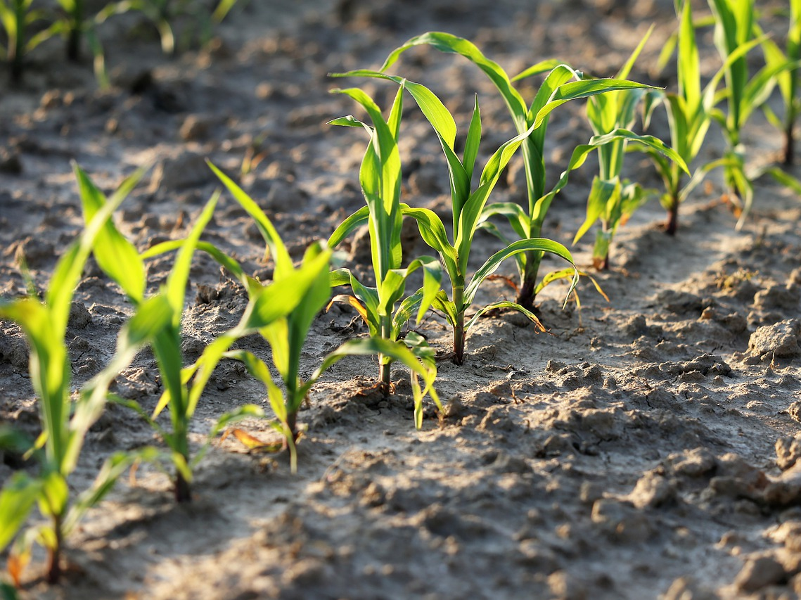
Global Agrochemicals Market Outlook

Slide 11
Global Agrochemicals Market, By Value & Volume
Figure 1: Global Agrochemicals Market Size, By Value (USD Billion) & By Volume (in MMT), 2017, 2021, 2025F, 2030F, 2035F, 2040F
CAGR 2017-2021
By Value: 2.9%
CAGR 2021-2030F
By Value: 4.5%
CAGR 2030-2040F
By Value: 3.4%
CAGR 2017-2021
By Volume: 2.3%
CAGR 2021-2030F
By Volume: 3.9%
CAGR 2030-2040F
By Volume: 3.0%
Global Agrochemicals market stood at USD 220 billion and is expected to reach USD 324 billion at a CAGR of 4.5% by 2030 and 454 billion by the end of 2040 at a CAGR of 3.4%.
Covid did not affected the agrochemicals market owing to increase in demand of consumables in that period.
Initiatives such as “Make in India” and the PLI Scheme improve the manufacturing sector dynamics of India, and hence more industries are established.
Source: ChemAnalyst

Slide 12
Global Agrochemicals Market, By Value
Figure 2: Global Agrochemicals Market, By Type, By Value (USD Billion), 2017, 2021, 2025F, 2030F, 2035F, 2040F
Total in USD Billion
197
220
256
324
390
454
Others: Biopesticides, etc.
Insecticides is India's most demanded Agrochemicals, having a market share of more than 50%, and it stood at USD 117.8 billion in FY2021.
In the forecast period, it is expected that insecticides will dominate the agrochemicals with a market share of over 50%.
Source: ChemAnalyst

Slide 13
Global Agrochemicals Market, By Volume
Figure 3: Global Agrochemicals Market, By Type, By Volume (MMT), 2017, 2021, 2025F, 2030F, 2035F, 2040F
Total in MMT
171
187
213
263
309
355
Others: Biopesticides, etc.
Source: ChemAnalyst

Slide 14
Demand Assessment of India Agrochemicals Market
Global Agrochemicals Market, FY2021
Listed 52 Agrochemicals Market, By Volume, FY2021
187.2 Million Metric Tonnes
Global Agrochemicals Market, 2021-2030 CAGR 3.9%
Listed 52 Agrochemicals Market, 204.1 KT
India Agrochemicals Market, 4.2 MMT
~95%
~5%
Source: ChemAnalyst
Consumption of Insecticides in Descending Order
1.Cartap 4G | 11.Thiamethoxam 25 WG
2.Chlorpyriphos 20 EC | 12.Acetamiprid 20 SP
3.Profenophos 50 EC | 13.Imidacloprid 17.8 SL
4.Profenophos 40 +Cypermethrin 4 EC | 14.Diafenthiuron 50 WP
5.Chlorpyriphos 50 EC | 15.Emamectin Benzoate 5 SG
6.Cypermethrin 5% Chlorpyrephos 50% EC | 16.Pymetrozine 50 WG
7.Fipronil 5 SC | 17.Dinotefuran 20%
8.Bifenthrin 10 EC | 18.Fipronil 0.3 Gr
9.Spinetoram 11.70 SC | 19.Fipronil 40% Imidacloprid 40% WG
10.Acephate 50 +Imidacloprid 1.8 SP
Consumption of Fungicides in Descending Order
1.Carbendazim 50 WP | 8.Propiconazole 25 EC
2.Sulphur 80 WDG | 9.Copper Oxychloride 50 W
3.Mancozeb 75 WP | 10.Azoxystrobin 11 % + Tebuconazole 18.3 % SC
4.Tricyclazole 75 WP | 11.Tebuconazole 50%+ Trifloxystrobin 25% : Nativo
5.Thifluzamide 24SC | 12.Azoxystrobin 18.2%+ Difenoconazole 11.4%
6.Carbendazim 12 +Mancozeb 63 WP | 13.Paclobutrazole 25%
7.Hexaconazole 5% EC | 14.Metalaxyl8 +Mancozeb 64
Consumption of Herbicides in Descending Order
1.Paraquat 24 SL | 8.Oxyfluorfen 23.5 EC
2.2,4 D 58 EC (Amine Salt) | 9.Metribuzin 70 WP
3.Atrazine 50 WP | 10.Pyrazosulfuron
4.Pendimethalin 30 EC | 11.Bispyribac Sodium 10 SC
5.Pretilachlor 50 EC | 12.Glufonisate Ammonium 13.5% SL
6.Pendimethalin 38.7% CS | 13.Metribuzin 70 WP
7.Glyphosate | 14.Imazethapyr 10 SL

Slide 15
India Agrochemicals Market Outlook

Slide 16
India Agrochemicals Market, By Value & Volume
Figure 4: India Agrochemicals Market Size, By Value (USD Billion) & By Volume (in MMT), 2017, 2021, 2025F, 2030F, 2035F, 2040F
CAGR 2017-2021
By Value: 8.3%
CAGR 2021-2030F
By Value: 10.4%
CAGR 2030-2040F
By Value: 8.4%
CAGR 2017-2021
By Volume: 8.0%
CAGR 2021-2030F
By Volume: 9.8%
CAGR 2030-2040F
By Volume: 8.1%
India Agrochemicals market stood at USD 6.3 billion and is expected to reach USD 15.2 billion at a CAGR of 10.4% by 2030 and 34.7 billion by the end of 2040 at a CAGR of 8.4%.
India is the fourth-largest producer of agrochemicals in the world after USA, Japan and China.
The major dynamics to the agrochemicals market includes, decreasing arable land, declining soil fertility, heavy dependency on monsoon for irrigation and many more.
Source: ChemAnalyst

Slide 17
India Agrochemicals Market, By Value
Figure 5: India Agrochemicals Market, By Type, By Value (USD Billion), 2017, 2021, 2025F, 2030F, 2035F, 2040F
Total in USD Billion
5
6
9
15
24
35
Others: Biopesticides, etc.
Source: ChemAnalyst

Slide 18
India Agrochemicals Market, By Volume
Figure 6: India Agrochemicals Market, By Type, By Volume (MMT), 2017, 2021, 2025F, 2030F, 2035F, 2040F
Total in MMT
3
4
6
10
15
21
Others: Biopesticides, etc.
Source: ChemAnalyst

Slide 19
India Agrochemicals Market, By Value
Figure 7: India Agrochemicals Market, By Region, By Value (USD Billion), 2017, 2021, 2025F, 2030F, 2035F, 2040F
Total in USD Billion
5
6
9
15
24
35
Others: Biopesticides, etc.
Source: ChemAnalyst

Slide 20
India Agrochemicals Market, By Volume
Figure 8: India Agrochemicals Market, By Region, By Volume (MMT), 2017, 2021, 2025F, 2030F, 2035F, 2040F
Total in MMT
3
4
6
10
15
21
Others: Biopesticides, etc.
Source: ChemAnalyst

Slide 21
India Agrochemicals Market Share, By Company, By Volume, FY 2021
The Agrochemicals market in India is dominated by UPL Limited with 11.4% market share, followed by PI Industries Limited constituting around 10.3% market share.
Source: ChemAnalyst

Slide 22
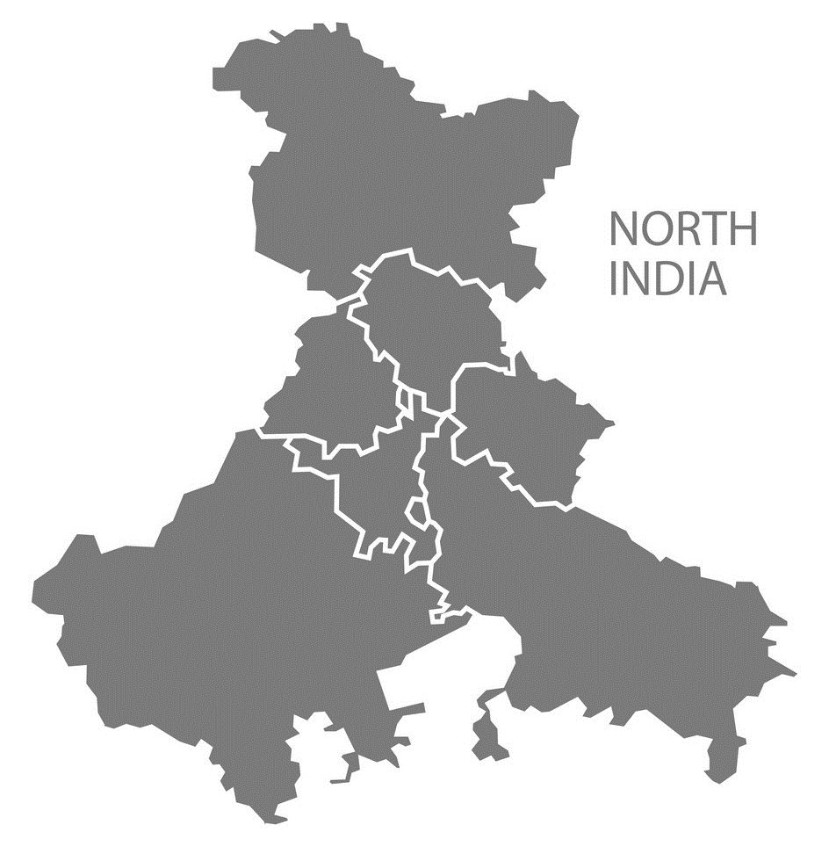
North India Agrochemicals Market Outlook

Slide 23
North India Agrochemicals Market, By Value & Volume
Figure 9: North India Agrochemicals Market Size, By Value (USD Billion) & By Volume (in MMT), 2017, 2021, 2025F, 2030F, 2035F, 2040F
CAGR 2017-2021
By Value: 8.34%
CAGR 2021-2030F
By Value: 10.31%
CAGR 2030-2040F
By Value: 8.58%
CAGR 2017-2021
By Volume: 7.98%
CAGR 2021-2030F
By Volume: 9.83%
CAGR 2030-2040F
By Volume: 8.32%
North India Agrochemicals market stood at USD 1.9 billion and is expected to reach USD 4.6 billion at a CAGR of 9.83% by 2030 and 10.4 billion by the end of 2040 at a CAGR of 8.32%.
The main factors propelling the India insecticide segment growth are capabilities for low-cost manufacture, the availability of technically skilled resources, seasonal domestic demand, overcapacity, greater price realization, and a significant presence in generic pesticide manufacturing.
Specialty chemicals have emerged as an appealing new market that has seen significant growth, fresh investment, and capacity expansion among Indian businesses in the agrochemical industry.
Source: ChemAnalyst

Slide 24
North India Agrochemicals Market, By Value
Figure 10: North India Agrochemicals Market, By Type, By Value (USD Billion), 2017, 2021, 2025F, 2030F, 2035F, 2040F
Total in USD Billion
1
2
3
5
7
10
Others: Biopesticides, etc.
Source: ChemAnalyst

Slide 25
North India Agrochemicals Market, By Volume
Figure 11: North India Agrochemicals Market, By Type, By Volume (MMT), 2017, 2021, 2025F, 2030F, 2035F, 2040F
Total in MMT
1
1
2
3
4
6
Others: Biopesticides, etc.
Source: ChemAnalyst

Slide 26
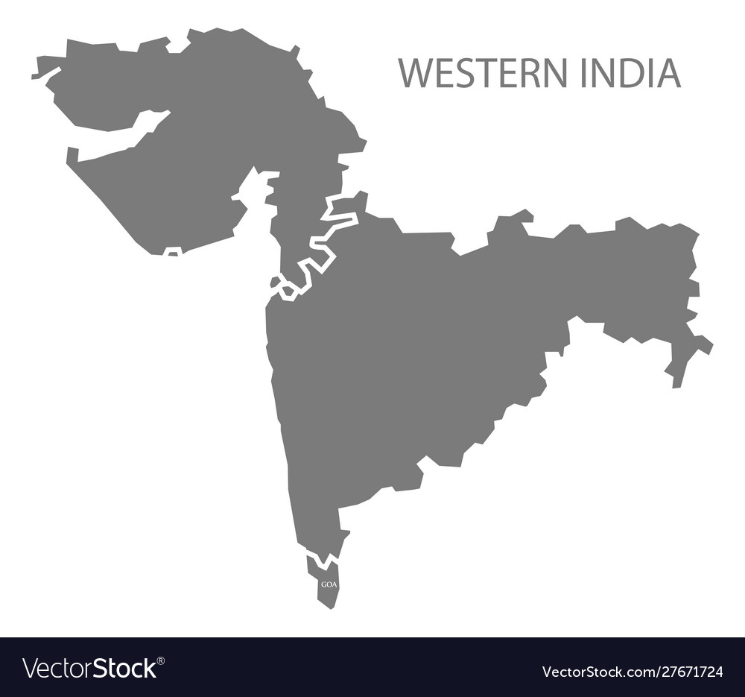
West India Agrochemicals Market Outlook

Slide 27
West India Agrochemicals Market, By Value & Volume
Figure 12: West India Agrochemicals Market Size, By Value (USD Billion) & By Volume (in MMT), 2017, 2021, 2025F, 2030F, 2035F, 2040F
CAGR 2017-2021
By Value: 8.4%
CAGR 2021-2030F
By Value: 10.4%
CAGR 2030-2040F
By Value: 8.6%
CAGR 2017-2021
By Volume: 8.1%
CAGR 2021-2030F
By Volume: 9.9%
CAGR 2030-2040F
By Volume: 8.3%
West India Agrochemicals market stood at USD 1.2 billion and is expected to reach USD 2.8 billion at a CAGR of 9.9% by 2030 and 6.5 billion by the end of 2040 at a CAGR of 8.3%.
The decline in arable land, shrinking farms, rise in insect attacks, and low per hectare yield position that the Indian agriculture industry is currently experiencing are having a favorable effect on the country's agrochemical business.
Due to the seasonal nature of the agrochemical market in India, which can meet international demand during the off-peak seasons, these factors are likely to make India a global manufacturing hub.
Source: ChemAnalyst

Slide 28
West India Agrochemicals Market, By Value
Figure 13: West India Agrochemicals Market, By Type, By Value (USD Billion), 2017, 2021, 2025F, 2030F, 2035F, 2040F
Total in USD Billion
1
2
2
3
4
6
Others: Biopesticides, etc.
Source: ChemAnalyst

Slide 29
West India Agrochemicals Market, By Volume
Figure 14: West India Agrochemicals Market, By Type, By Volume (MMT), 2017, 2021, 2025F, 2030F, 2035F, 2040F
Total in MMT
1
1
1
2
3
4
Others: Biopesticides, etc.
Source: ChemAnalyst

Slide 30
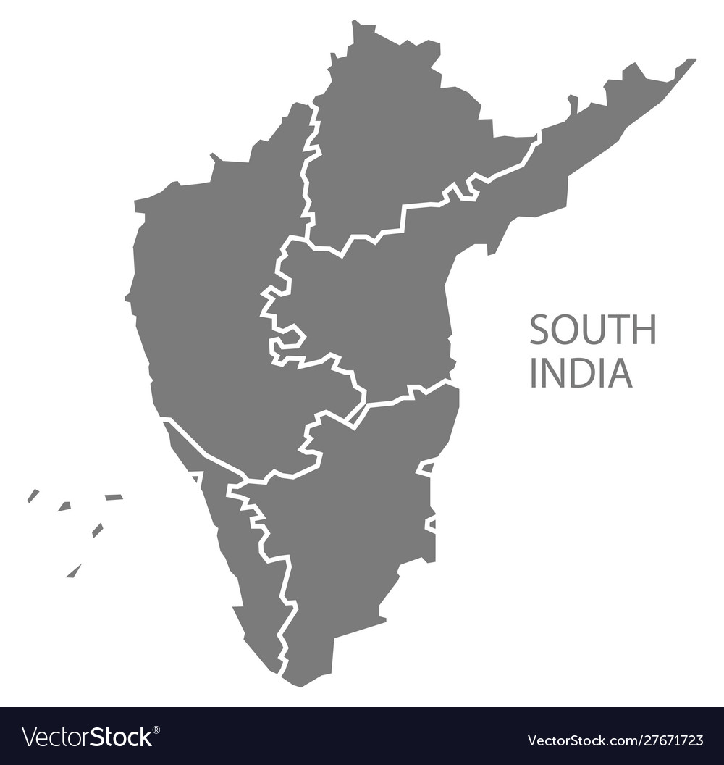
South India Agrochemicals Market Outlook

Slide 31
South India Agrochemicals Market, By Value & Volume
Figure 15: South India Agrochemicals Market Size, By Value (USD Billion) & By Volume (in MMT), 2017, 2021, 2025F, 2030F, 2035F, 2040F
CAGR 2017-2021
By Value: 8.3%
CAGR 2021-2030F
By Value: 10.4%
CAGR 2030-2040F
By Value: 8.6%
CAGR 2017-2021
By Volume: 8.0%
CAGR 2021-2030F
By Volume: 9.8%
CAGR 2030-2040F
By Volume: 8.3%
South India Agrochemicals market stood at USD 2.0 billion and is expected to reach USD 4.9 billion at a CAGR of 9.8% by 2030 and 11.1 billion by the end of 2040 at a CAGR of 8.3%.
To raise the output of agriculture, it is necessary to increase crop production with pest control and weed management techniques. And crucial game-changers for achieving this objective are the sourcing of raw materials for manufacturing and the distribution of agrochemicals to the consumption sites.
Weather conditions and rainfall patterns have a big impact on consumption. Higher temperatures and humidity cause pest infestations to be more severe, which increases the need for pesticides.
Source: ChemAnalyst

Slide 32
South India Agrochemicals Market, By Value
Figure 16: South India Agrochemicals Market, By Type, By Value (USD Billion), 2017, 2021, 2025F, 2030F, 2035F, 2040F
Total in USD Billion
1
2
3
5
8
11
Others: Biopesticides, etc.
Source: ChemAnalyst

Slide 33
South India Agrochemicals Market, By Volume
Figure 17: South India Agrochemicals Market, By Type, By Volume (MMT), 2017, 2021, 2025F, 2030F, 2035F, 2040F
Total in MMT
1
1
2
3
4
6
Others: Biopesticides, etc.
Source: ChemAnalyst

Slide 34
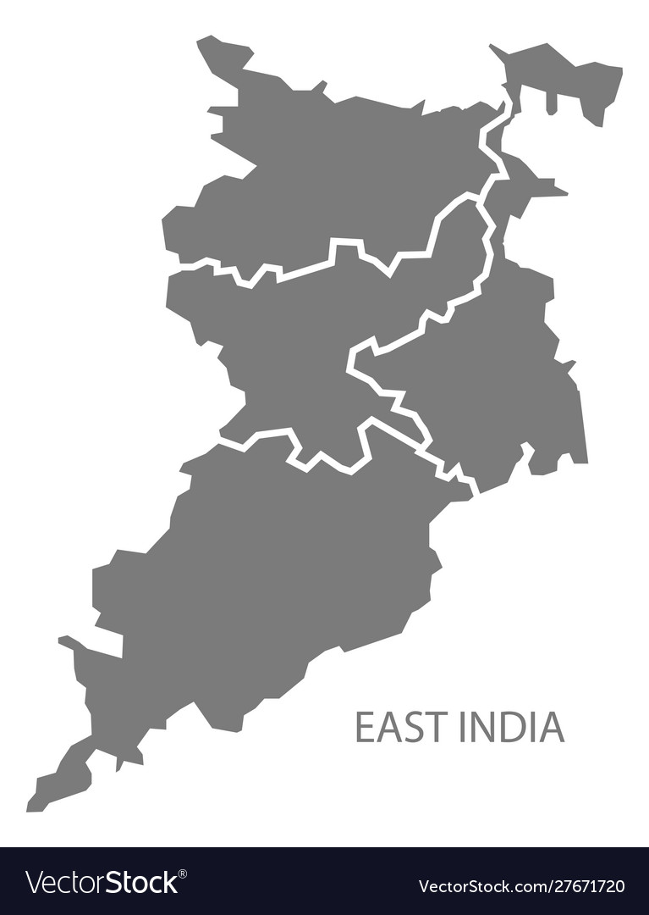
East India Agrochemicals Market Outlook

Slide 35
East India Agrochemicals Market, By Value & Volume
Figure 18: East India Agrochemicals Market Size, By Value (USD Billion) & By Volume (in MMT), 2017, 2021, 2025F, 2030F, 2035F, 2040F
CAGR 2017-2021
By Value: 8.2%
CAGR 2021-2030F
By Value: 10.1%
CAGR 2030-2040F
By Value: 8.5%
CAGR 2017-2021
By Volume: 7.9%
CAGR 2021-2030F
By Volume: 9.6%
CAGR 2030-2040F
By Volume: 8.2%
East India Agrochemicals market stood at USD 1.2 billion and is expected to reach USD 3.0 billion at a CAGR of 9.6% by 2030 and 6.7 billion by the end of 2040 at a CAGR of 8.2%.
The Indian government has named the agrochemical industry as one of the 12 industries with the potential to assume a leadership position in the world, which must be a significant component in the overall expansion of the agrochemical industry in India.
The entire agrochemicals ecosystem in India is being impacted by evolving models including direct selling through FPOs and direct-to-consumer (D2C) channels like e-commerce.
Source: ChemAnalyst

Slide 36
East India Agrochemicals Market, By Value
Figure 19: East India Agrochemicals Market, By Type, By Value (USD Billion), 2017, 2021, 2025F, 2030F, 2035F, 2040F
Total in USD Billion
1
1
2
3
5
35
Others: Biopesticides, etc.
Source: ChemAnalyst

Slide 37
East India Agrochemicals Market, By Volume
Figure 20: East India Agrochemicals Market, By Type, By Volume (MMT), 2017, 2021, 2025F, 2030F, 2035F, 2040F
Total in MMT
1
1
1
2
4
5
Others: Biopesticides, etc.
Source: ChemAnalyst

Slide 38
Supply and Demand Analysis (MMT), Planned Investment
Parameters | FY2017 | FY2019 | FY2021 | FY2025 | FY2030 | FY2035 | FY2040
Production | 3.6 | 4.4 | 5.1 | 5.7 | 6.0 | 6.3 | 6.5
Import | 0.7 | 0.9 | 1.1 | - | - | - | -
Export | 1.2 | 1.7 | 2.0 | - | - | - | -
Demand | 3.0 | 3.6 | 4.2 | 6.0 | 9.6 | 14.8 | 21.4
Surplus/Gap | - | - | - | -0.3 | -3.6 | -8.5 | -14.9
Existing Capacity | 4.5 | 5.0 | 6.3 | 7.0 | 7.0 | 7.0 | 7.0
In 2021, the overall production of agrochemicals in India stood at 5.1 MMT and had an existing capacity of 6.3 MMT.
Till now industry is operating at approximately 80% of the overall existing capacity.
Planned Investment
PI INDUSTRIES LIMITED | Brownfield expansion of Panoli plant for manufacturing pesticides and pharma
GHARDA CHEMICALS LIMITED | Gharda chemicals plans to setup a 4,36,070 TPA pesticides and organic chemcials manufacturing plant in Pune.
TAGROS CHEMICALS INDIA PVT. LIMITED | Tagros proposed amalgamation and expansion of Pesticide Intermediates & Technical production capacity from 1195 Ton/Month to 2193 Ton/Month along with synthetic organic chemical existing production capacity of 1000 Ton/Month in Panoli, Gujarat location.
COROMANDEL INTERNATIONAL | Proposed Expansion of Pesticide and Pesticide Intermediate 49300 to 79316 MT Per Annum at Bharuch, Gujarat Manufacturing Plant.

Slide 39
Import & Export, By Volume
Export Top 5 Countries, By Volume (Kilo Tons)
Import Top 5 Countries, By Volume (Kilo Tons)
India exported 2035.7 Kilo tons of agrochemicals in FY 2021.
India exported majorly to Brazil, USA, Bangladesh and Vietnam nations.
India imported 1132.0 Kilo tons of agrochemicals in FY 2021.
Imports of agrochemicals majorly came from China, USA and Israel.

Slide 40
Value Chain- Agrochemicals
Manufacturer/Producer
Margin: 5% to 7%
Margin: 8% to 15%
Distributor/Agents
Margin: 1.5% to 3%
Custom Duty: 10% , GST: 18%
End User
The profit margin for agrochemicals manufacture is ranging from 5% to 7%. Whereas Distributor/Agents margin is between 1.5% to 3% .
Manufacturer while dealing directly with the end user take profit ranging from 8% to 15% depending upon the nature of contract that depends upon quantity, payment terms etc.

Slide 41
Market Dynamics
Drivers
With increase in population, the nutritional demand also increases, and agrochemicals is one of the key chemical help to satisfy the increasing nutritional demand.
The lack of water and land, people are using fertilizers and pesticides to help them cultivate a variety of crops in constrained areas, which leads to the expansion of the agrochemicals market.
After COVID-19, to meet global demand Indian agrochemical companies increased backward integration which has a strong impact in the growth of agrochemical market.
One of the top 12 industries for achieving global leadership, according to the Indian government, is the agrochemical sector, which is expected to develop at an 8% to 10% rate through 2025
Challenges
The growth of the agrochemicals market may be constrained by rising environmental dangers from pesticides and fertilizers. Growing demand for organic food items and growing usage of biofertilizers are impeding the use of chemical fertilizers.
Higher concentrations of agrochemical use pollute surface waters and have negative environmental effects.

Slide 42

COMPETITIVE LANDSCAPE

Slide 43

UPL LIMITED
UPL Limited, formerly known as Universal Phosphorus Limited, has established in 1969 in Mumbai and now serving globally.
The company claims to be the number 1 and 5 in India and the world, respectively, in agrochemical production.
The company offers various agrochemicals started with the production of Yellow Phosphorus in Ankleshwar, Gujarat.
Since 1969, UPL has acquired Arysta LifeScience, Bioseen, BioQuim, Kudos Chemie Limited, and product acquisition of Surflan (USA).
The company is India’s biggest exporter of agrochemicals.
The company has a presence in over 138 countries and is concentrating on developing a portfolio that adds value for growers across all the market sectors.
To make agriculture sustainable in India and global level, UPL is working on manufacturing and supply chain processes and a product portfolio. The company’s Indian business grew at 22% Y-O-Y basis, whereas North America and Latin America grew at 37% and 21% Y-O-Y basis, respectively.
North
West
East
South
Business Setup, FY2021
HQ | Vapi, Gujarat
Plants | Gujarat: Jhagadia, Ankleshwar, Vapi, Halol Telangana: Hyderabad West Bengal: Haldia Jammu & Kashmir: Jammu
Key Indicators
Plant Capacity | 300,000 MT
Production Volume, 2021 | 250,000 MT
Total Revenue, FY 2021 | INR 5,687 Crores
Profit After Tax (PAT) | INR 578 Crores

Slide 44

PI INDUSTRIES LIMITED
PI industries were founded in 1946 and incorporated as Mewar Oil & General Mills Ltd. in Udaipur and has a physical presence in India, China, Germany, and Japan.
The company claims to be one of India's top Agrisciences and fine chemical companies with a distinctive business strategy of offering farmers cutting-edge farm solutions.
The company offers a variety of Insecticides, Fungicides, and Herbicides under the Agrochemical segment.
PI is the oldest and largest CSM player in the world markets from India and focuses on quickly diversifying its product line to include agrochemicals, electronic chemicals, and pharmaceuticals.
PI Industries has a strong marketing network of over 1,00,000 retailers and over 10,000 distributors standalone for crop protection brands.
The company entered a specialized niche market by successfully commercializing nine new molecules during 2021-22, including two new electronic chemicals.
PI Industries is committed to de-risking the supply chain and ensuring supply sustainability by reducing reliance on single sources.
North
West
East
South
Business Setup, FY2021
HQ | Udaipur, Rajasthan
Plants | Ankleshwar (Gujarat) [3 formulations plant and multiproduct technical manufacturing plants
Key Indicators
Plant Capacity | 270,000 MT
Production Volume, 2021 | 230,000 MT
Total Revenue, FY 2021 | INR 4387 Crores
Profit After Tax (PAT) | INR 421 Crores

Slide 45

GHARDA CHEMICALS LIMITED
Gharda Chemicals Limited (GCL) was founded in 1967 as a research-based company. Now, Gharda is one of the prosperous and well-established company in the agrochemical segment.
Gharda continues to have a significant presence in the domestic and global market in developing agrochemicals on reasonably priced and import-substitute products.
Gharda develops many new products in dyestuffs, insecticides, veterinary pharmaceuticals, and polymers and has earned numerous national awards for technological innovation in the chemical sector.
Gharda is the only Indian company to gain EPA approval for Chlorpyrifos (an insecticide) and Dicamba (an herbicide) sales in the United States of America (USA).
Gharda is socially conscious and makes an effort to assist numerous philanthropic endeavors through programs like the Gharda Foundation, Gharda Institute of Technology, Gharda Hospital, and Gharda Library.
Gharda continues to improve its technology with the help of a robust R&D program and its competence in process development.
North
West
East
South
Business Setup, FY2021
HQ | Ankleshwar, Gujarat
Plants | Maharashtra: Lote, Dombivili Gujarat: Panoli, Ankleshwar Jammu & Kashmir: Jammu
Key Indicators
Plant Capacity | 230,000 MT
Production Volume, 2021 | 190,000 MT
Total Revenue, FY 2021 | INR 3,170 Crores
Profit After Tax (PAT) | INR 574 Crores

Slide 46

TAGROS CHEMICALS INDIA PVT. LIMITED
Tagros is the flagship company of Jhaver Group, established in 1992 as Tagros Chemicals India Limited in Chennai, Tamil Nadu.
With a smooth customer experience, Tagros has the scalability and capacity to provide top-tier agrochemical solutions.
Tagros has a presence in over 90 countries. Tagros is a leading producer of agrochemicals with a reputation for excellence in crop protection and related industries.
The veterinary, public health and agricultural sectors are all served globally by Tagros Chemicals India. The Company produces and exports synthetic pyrethroids, pesticide intermediates, fungicides, rodenticides, plant nutrients, seed treatments, and veterinary, and wood protection products.
Key customers of Tagros in the export market include BASF SE, Limaru NV, Beijing Lucky Star International Ltd, etc., and in the domestic market, the key customers are Willwood Chemicals Private Limited, Godrej Consumer Products Limited, Sharda Cropchem Limited, etc.
In 2009, Tagros acquired Gujarat Agrochem Limited (GAL), which also manufactures the same products as Tagros.
North
West
East
South
Business Setup, FY2021
HQ | Chennai, Tamil Nadu
Plants | Gujarat: Dahej, Panoli Tamil Nadu: Cuddalore
Key Indicators
Plant Capacity | 200,000 MT
Production Volume, 2021 | 170,000 MT
Total Revenue, FY 2021 | INR 2432 Crores
Profit After Tax (PAT) | INR 243 Crore

Slide 47

COROMANDEL INTERNATIONAL
Coromandel International is a part of Murugappa Group, founded in 1960 and headquartered in Hyderabad, Telangana.
Coromandel has 16 manufacturing facilities where they produce fertilizers and crop protection chemicals.
The company registered 35% growth in 2021-22 over the previous year.
In the year 2021-22, Coromandel filed 113 patents, of which 18 were granted In 2021-22, Coromandel launched nine new products Groshakti Plus, Accu Mist Zinc, etc.
Coromandel is the largest producer of neem-based biopesticide in the world, dedicated to innovating and upgrading company’s portfolio towards greener chemistry.
Coromandel is leading the effort to automate farms by partnering with major players in the technology industry and creating unique solutions for farmers.
This year, the Coromandel business of crop protection witnessed a top-line increase of 21% from last year.
The COVID-19 pandemic leads to disruptions in the supply chain, which leads coromandel to diversify its sourcing and look for other alternatives.
North
West
East
South
Business Setup, FY2021
HQ | Secunderabad, Telangana
Plants | Gujarat (4): Ankleshwar, Dahej, Sarigam, Baroda Tamil Nadu (4): Thyagavalli, Ranipet, Ennore, Ranipet Andhra Pradesh (2): Vizag, Kakinada, Rajasthan (3): Udaipur, Kota, Pali, Madhya Pradesh (1): Nimrani, Jammu & Kashmir (1): Jammu ,Karnataka (1): Hospet, Uttar Pradesh (1): Raebareli
Key Indicators
Plant Capacity | 180,000 MT
Production Volume, 2021 | 130,000 MT
Total Revenue, FY 2021 | INR 2315 Crore
Profit After Tax (PAT) | INR 201 Crore

Slide 48

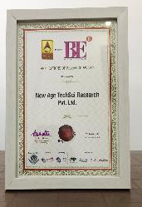
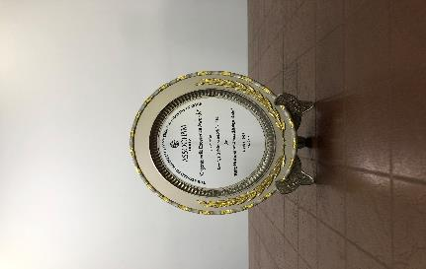

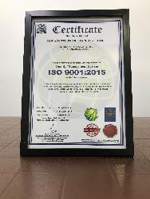
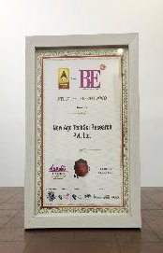
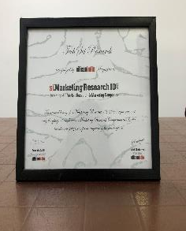
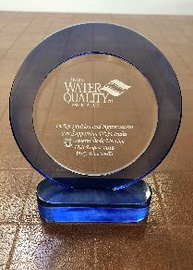

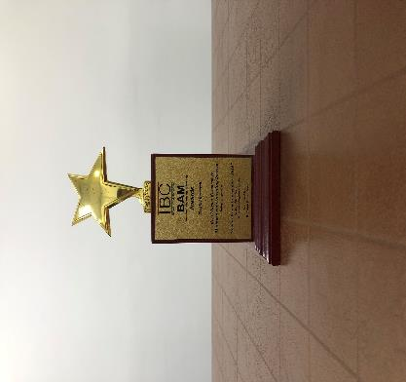
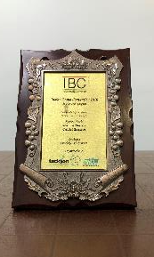
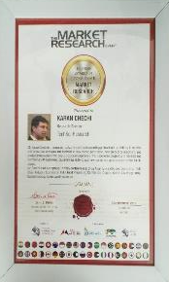
ChemAnalyst- Awards & Recognition
Best Application of Research Award at World Marketing Congress by ABP News ( 2018 )
Organic India Excellence Awards by ASSOCHAM India (2018)
Business-to-Business Research Award at Brand Excellence Awards by ABP News (2018)
Quality Management System by ISO (2018)
Best Application of Research Award at World Marketing Congress by ABP News ( 2017 )
Award for Best Place to Work in Research at World Marketing Congress by ABP News (2017)
Recognition from Silicon India Magazine
Recognition & Appreciation from WQIA
Best Market Research & Management Consulting Manufacturing Processby Wafisilpa Entertainments
Leadership Award from World Marketing Congress
Leadership Award from World Marketing Congress

Slide 49





























Our Prestigious Clients Who Bought Reports in Chemical Industry

Slide 50







Disclaimer :
The contents of this report are based on information generally available to the public from sources and primary interviews which are believed to be reliable. No representation is made that it is timely, accurate or complete. TechSci Research has taken due care and caution in compilation of data as this has been obtained from various sources including primary interviews which it considers reliable and firsthand. However, TechSci Research does not guarantee the accuracy, adequacy or completeness of any information and it is not responsible for any errors or omissions or for the results obtained from the use of such information and especially states that it has no financial liability whatsoever to the subscribers / users of this report. The information herein, together with all estimates and forecasts, can change without notice. All the figures provided in this document are indicative of relative market size and are strictly for client’s internal consumption. Usage of the same for purpose other than internal will require prior approval of TechSci Research.
CONTACT US
TechSci Research – North America
2950, Boundary Road, Burnaby, British Columbia, Canada
Tel: +1- 646- 360-1656
E: sales@techsciresearch.com
TechSci Research – Europe
54, Oldbrook, Bretton,
Peterborough,
United Kingdom
E: sales@techsciresearch.com
TechSci Research – Asia-Pacific
B-44, Sector -57, Noida, National Capital Region, UP, India
Tel: +91-120-4523900
E: sales@techsciresearch.com
TechSci Research
Cyber City, Building No. 8C, Gurgaon, National Capital Region, Haryana, India
Tel: +91-124-6428661
E: sales@techsciresearch.com
www.techsciresearch.com
INDUSTRY ASSOCIATIONS
The information contained herein is of a general nature and is not intended to address any particular situation, individual or entity. No one should act upon such information without appropriate professional advice.
2021 © TechSci Research All Rights Reserved.

